Slide 1
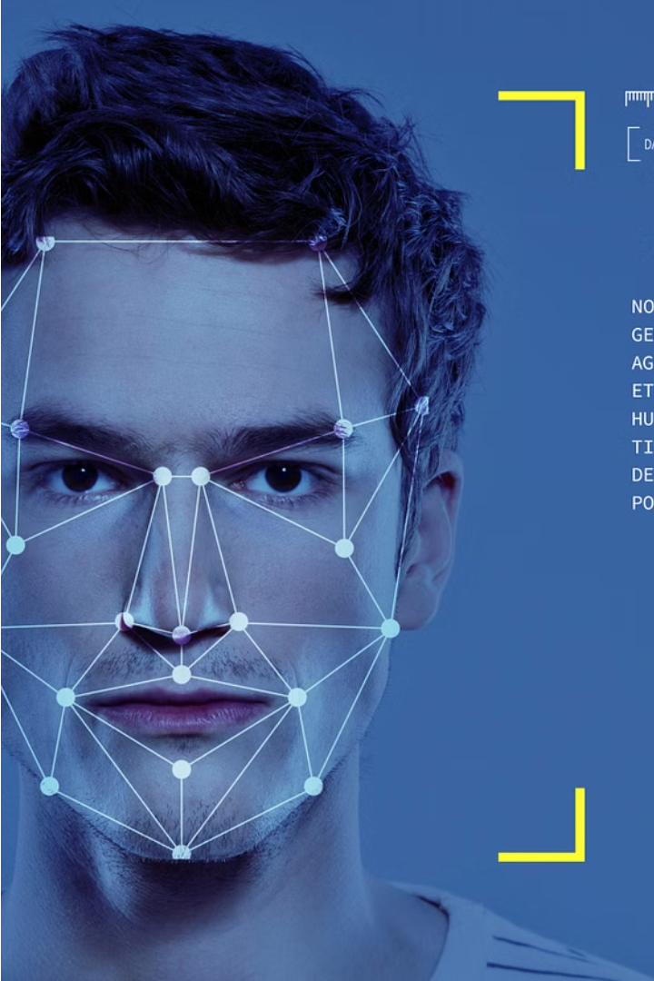
Face Mask Detector
The Face Mask Detection project is an intelligent computer vision system that automatically detects mask usage, ensuring public safety and preventing disease spread. Using a deep learning model with a convolutional neural network (CNN), it classifies images as "With Mask" or "Without Mask." It also enhances security in areas like ATMs, where masks are restricted. The system processes images, employs a robust CNN, evaluates performance with key metrics, and is deployed through a user-friendly Gradio interface a real-time detection GUI.
By , Ashutosh Ankush Mulay 23

Slide 2

Problem Statement
There is a need for an automated system that can accurately detect if people are wearing face masks. Manual monitoring is time-consuming. This is crucial for health reasons, as masks help prevent the spread of diseases. Additionally, in places like ATMs, people may misuse masks to hide their identities, creating security risks. Therefore, it's important to develop a reliable system to ensure public health, enforce mask rules, and improve security.

Slide 3
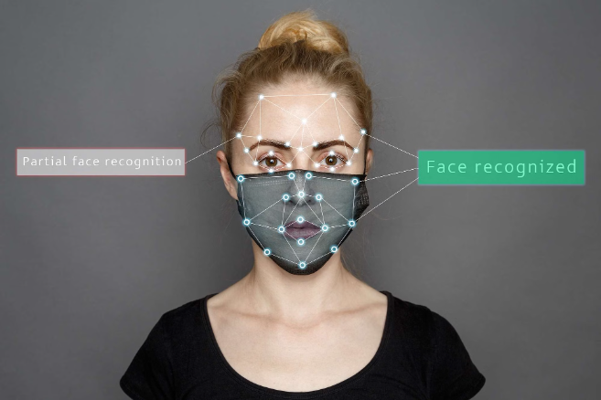
Introduction to face mask detector
The Face Mask Detector is a cutting-edge solution designed to automatically identify whether individuals are wearing protective face masks. In the wake of the COVID-19 pandemic, the widespread adoption of face masks has become crucial for public health and safety. This intelligent system utilizes advanced computer vision techniques, specifically a convolutional neural network (CNN), to analyze images and accurately classify them as "With Mask" or "Without Mask".
By leveraging this technology, organizations and authorities can enforce safety protocols in various public settings, reducing the risk of disease transmission. Additionally, the Face Mask Detector addresses security concerns, particularly in sensitive areas like ATMs, where masks may be misused for identity concealment. Overall, this innovative solution plays a pivotal role in promoting public health, safety, and security in today's challenging times.

Slide 4




How the Detector Works
Input Acquisition
The detector takes images containing individuals as input.
Preprocessing
The input images are resized, converted to RGB format, and normalized to ensure uniformity and compatibility with the model
Classification
A convolutional neural network (CNN) model analyzes the preprocessed images to classify them into two categories: "With Mask" or "Without Mask".
Prediction
Based on the CNN's analysis, the detector predicts whether each individual in the image is wearing a mask or not, providing a binary classification output.

Slide 5
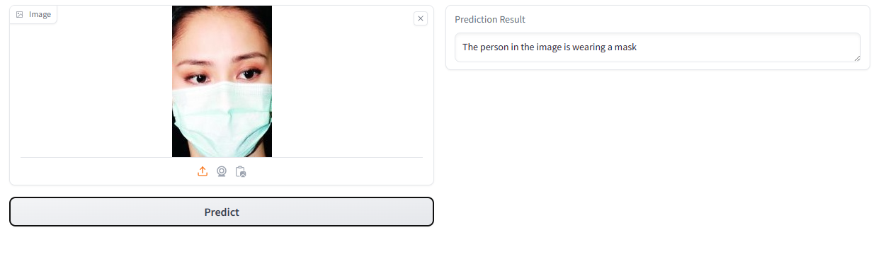
GUI & its working
Drop Image Here / Click to Upload: This is an area where the user can either drag and drop an image file or click to open a file explorer and select an image to upload.
Prediction Result: This is an empty box where the prediction or output related to the uploaded image will be displayed after clicking the "Predict" button.
Predict Button: When the user clicks this button after uploading an image, it initiates the prediction process. The backend processes the image using the saved convolutional neural network (CNN) model, analyzing it to determine if a mask is present, and the result is displayed in the "Prediction Result" box.
Social Media Icons: There are icons for sharing or exporting the prediction result or uploading a new image from various sources like a webcam or social media platforms.

Slide 6
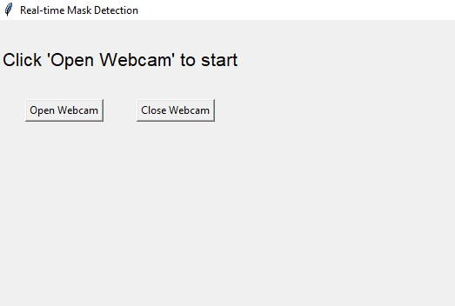
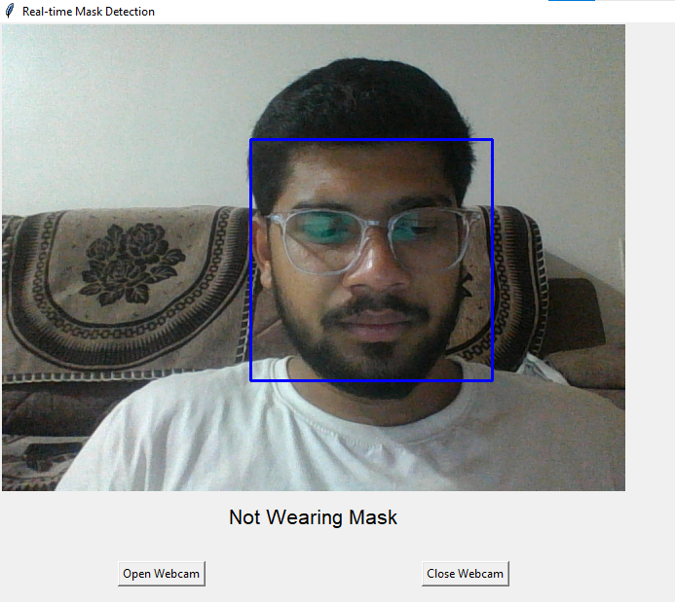
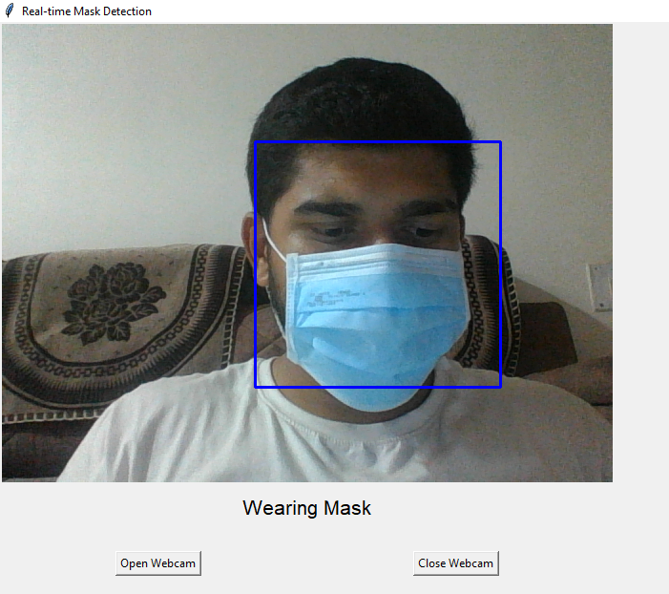
Build GUI for real time detection:
Working Of GUI:

Slide 7
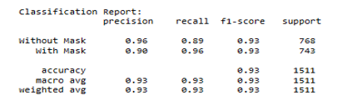
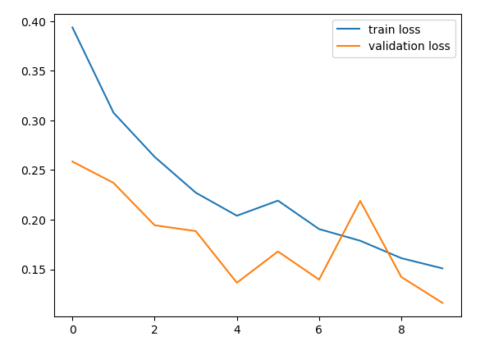
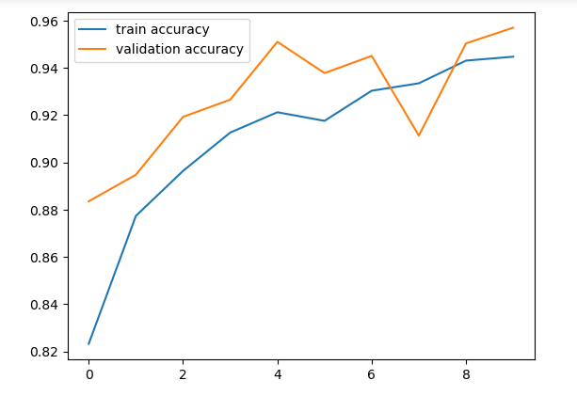
Accuracy of model

Slide 8



Key Features and Capabilities
Accurate Detection
Real-time Prediction
User-friendly Interface
The face mask detector uses advanced computer vision algorithms to accurately identify whether a person is wearing a mask or not, even in crowded or challenging environments.
Utilizing a trained convolutional neural network (CNN), the system provides real-time predictions, enabling quick decision-making.
With a Gradio interface, users can easily upload images and receive instant mask detection results, enhancing accessibility and usability.

Slide 9
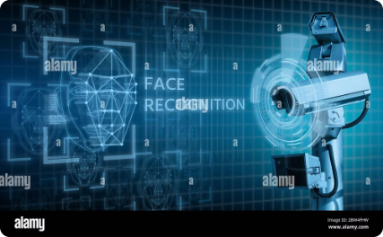
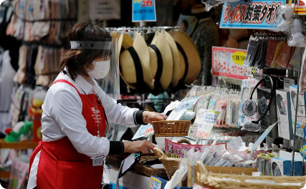
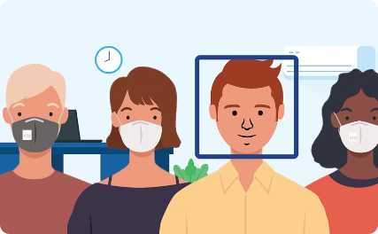
Real-World Applications
Security Enforcement
Retail Monitoring
Public Health monitoring
In high-security environments like banks, airports, and government buildings, the system can enforce regulations by detecting individuals attempting to conceal their identities with masks.
Retailers can deploy the face mask detector to monitor customer compliance with mask mandates, ensuring a safe shopping environment and preventing the spread of illnesses.
The system can be deployed in public spaces, such as airports, malls, and transportation hubs, to ensure compliance with face mask mandates and help prevent the spread of infectious diseases.

Slide 10

Conclusion and Future Enhancements
The Face Mask Detector significantly advances public health, safety, and security by promoting mask compliance and preventing the spread of diseases. It also enhances security in sensitive areas by monitoring mask usage.
Future enhancements will include real-time video analysis and integration with CCTV systems, making the detector more effective and adaptable to emerging needs.

Slide 11
Thank You

